Slide 1
I210 Information Infrastructure
Lab 5

Slide 2
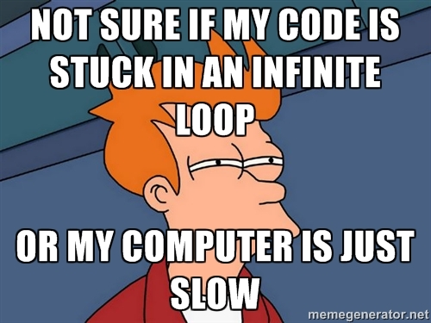
Topic
Today’s focus is files & while loops.

Slide 3
Quick Review - Basic File Use
#Either of these opens a file, reads it in as a string,
#prints out the string, then closes the file.
text_file = open("test.txt", "r")
file_contents = text_file.read()
text_file.close()
print(file_contents)
text_file = open("test.txt", "r")
file_contents = text_file.read()
print(file_contents)
text_file.close()

Slide 4
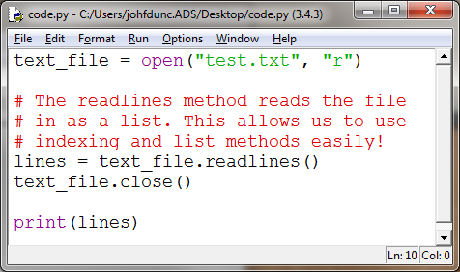
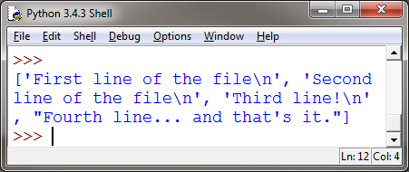
Quick Review - Reading from Files
You can also read lines into a list: (our default if you want to use list methods!)

Slide 5
Quick Review - Writing to a File
Make sure you close the file after writing to it!!
Nothing is actually written until you close the file.
text_file = open("write_it.txt", "w")
text_file.write("Line 1\n")
text_file.write("This is line 2\n")
text_file.write("That makes this line 3\n")
text_file.close()

Slide 6
Quick Review - Writing to a File
We can write from a list to a file:
lines = ["Line 1\n", "This is line 2\n", "That makes this line 3\n"]
text_file.writelines(lines)
Line 1
This is line 2
That makes this line 3
Lists are a great intermediary data structure for files!

Slide 7
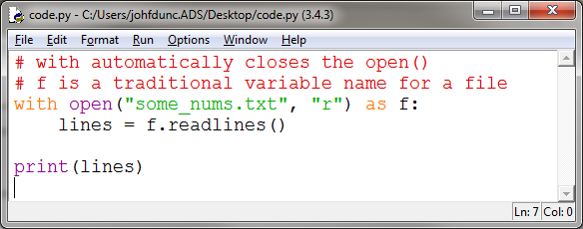
Quick Review - Files
This is an alternate way to interact with a file:
The with keyword creates a code block. After that code block finishes, the file is automatically closed!

Slide 8
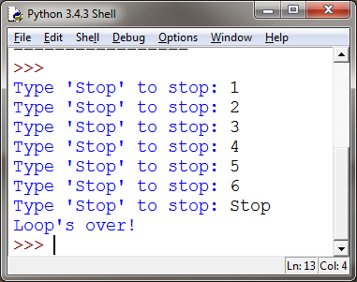
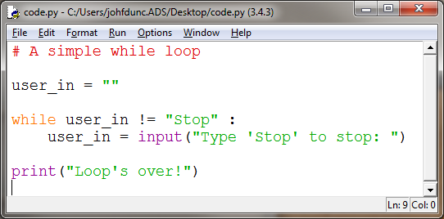
Quick Review - While loops

Slide 9
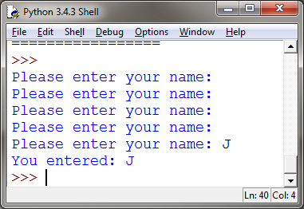
Quick Review - The break statement
while True:
name = input("Please enter your name: ")
# end loop if user enters something (Remember, "" is False)
if name:
break # appears on a line by itself!
print("You entered:", name)
while True: intentionally infinite loop
You must provide a break statement to leave the loop!

Slide 10
When to Use While Loops?
When is a good time to use a while loop?
Do you know many times a loop needs to run?
Are you validating an input?
(AIs / UIs share opinions on this)

Slide 11
Write a While (Group Work)
Write the first line of a while loop that would:
Run as long as the value of number was less than 100
Run until the value of username was a non-empty string.
Run until the variable cars contains an integer.

Slide 12
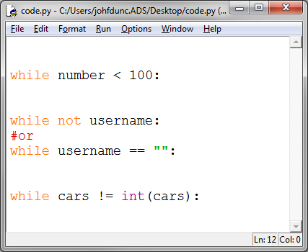
Write a While (Solution)

Slide 13
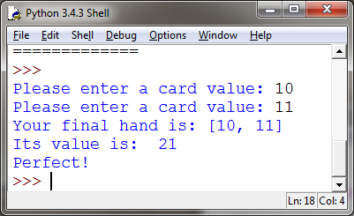
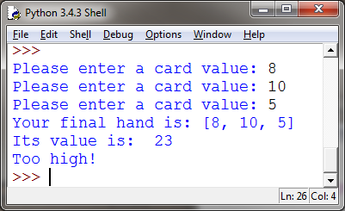
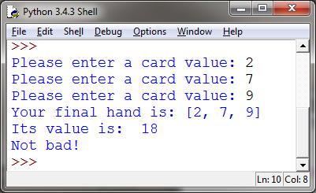
Blackjack (Group Work)
Write a program that simulates part of the Blackjack card game. Ask the user to enter each card’s value (a card can be worth between 1 and 11 points).
Run until the user hits 21, exceeds 21, or has 3 cards.

Slide 14
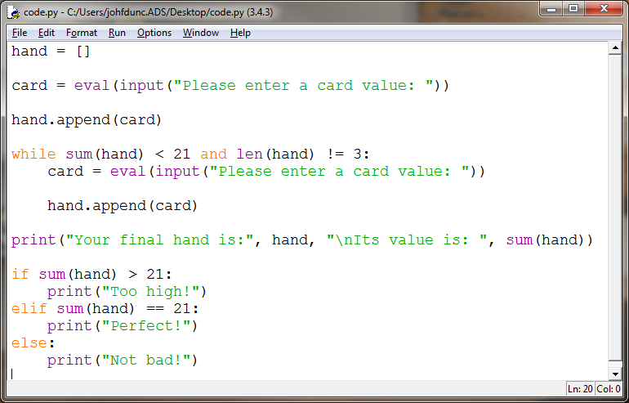
Blackjack (Solution 1)

Slide 15
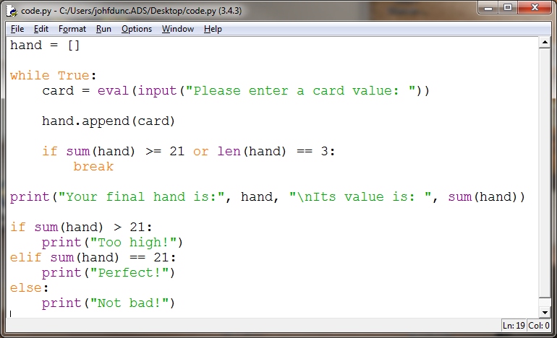
Blackjack (Solution 2)

Slide 16
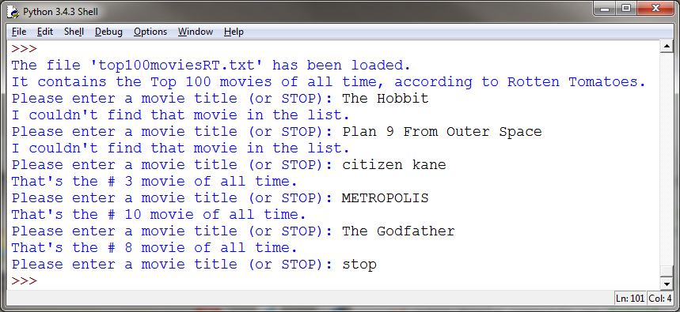
Top 100 Movies
Download the file top100moviesRT.txt from Canvas.
Replicate this program:

Slide 17
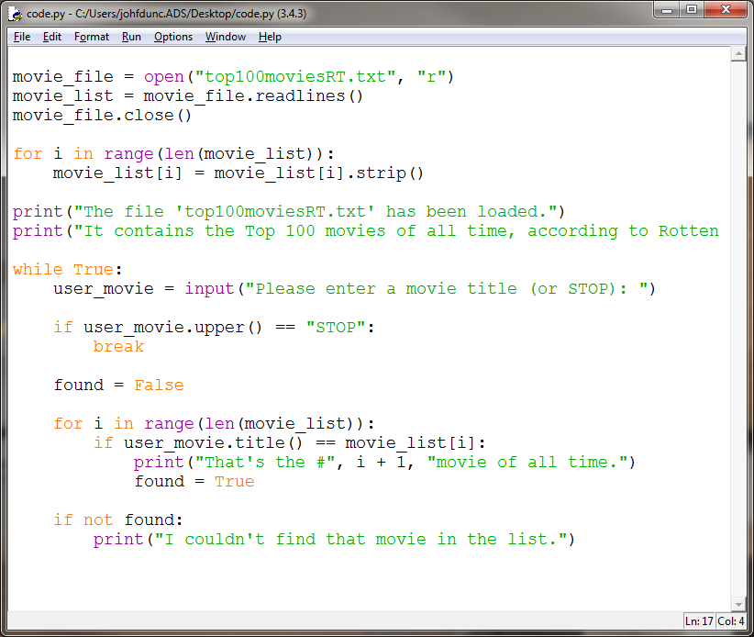
Top 100 Movies (Solution 1)

Slide 18
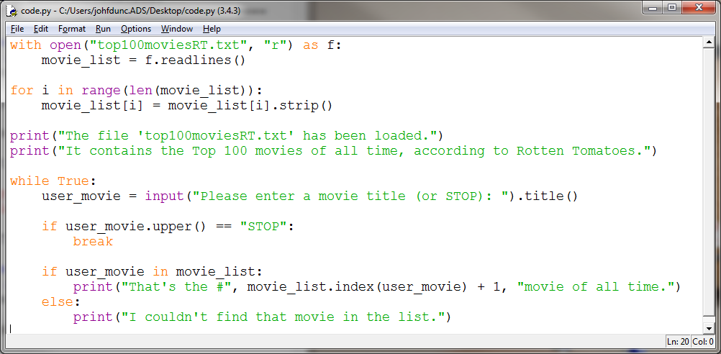
Top 100 Movies (Solution 2)

Slide 19
Questions?

